Slide 1
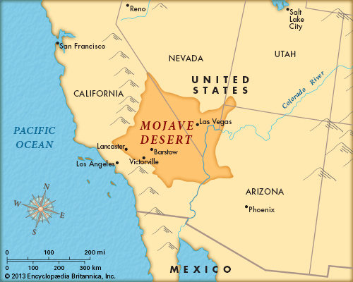
Mojave Extensional Belt, Southern California
Displacements on late Cenozoic strike-slip faults of the central Mojave Desert, California
Roy Dokka 1983
The Mojave Extensional Belt of Southern California
Roy Dokka 1989

Slide 2
Geologic Framework

Slide 3
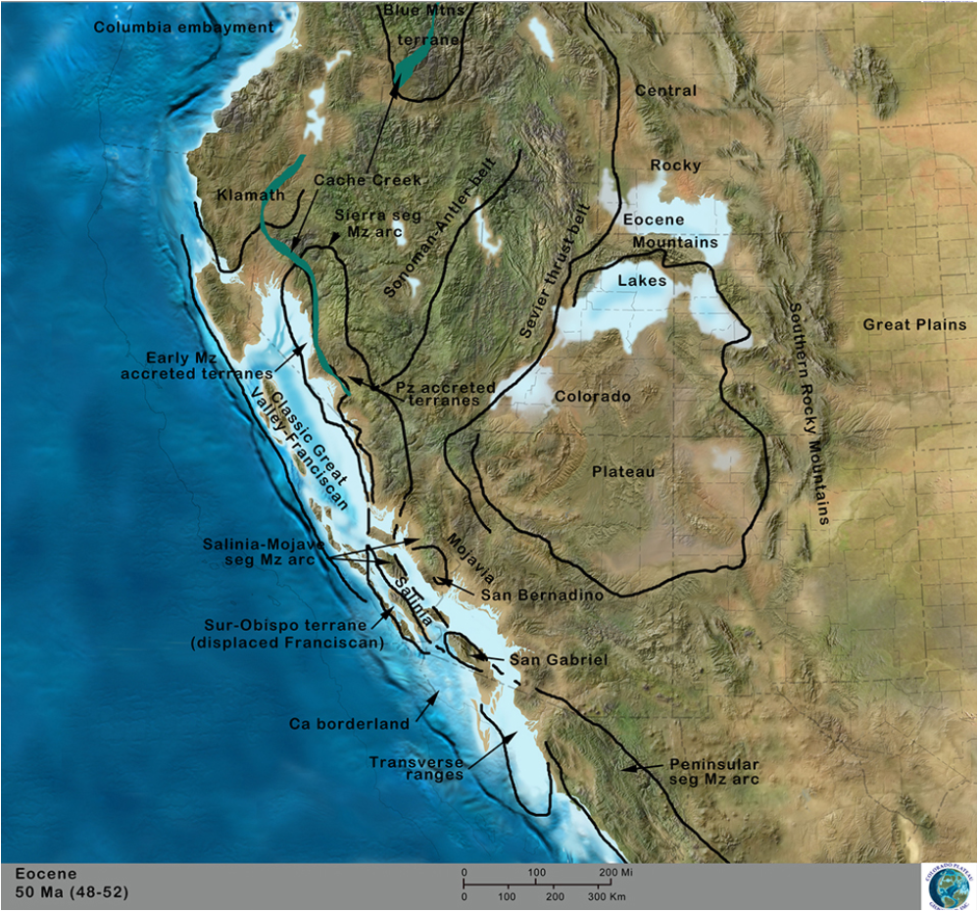
Note: The location of the Mendicino Triple Junction through time Emplacement of Santa Lucia-Orocopia Allochthon in Late Cretaceous ~70ma (San Gabriel) (Important later)

Slide 4
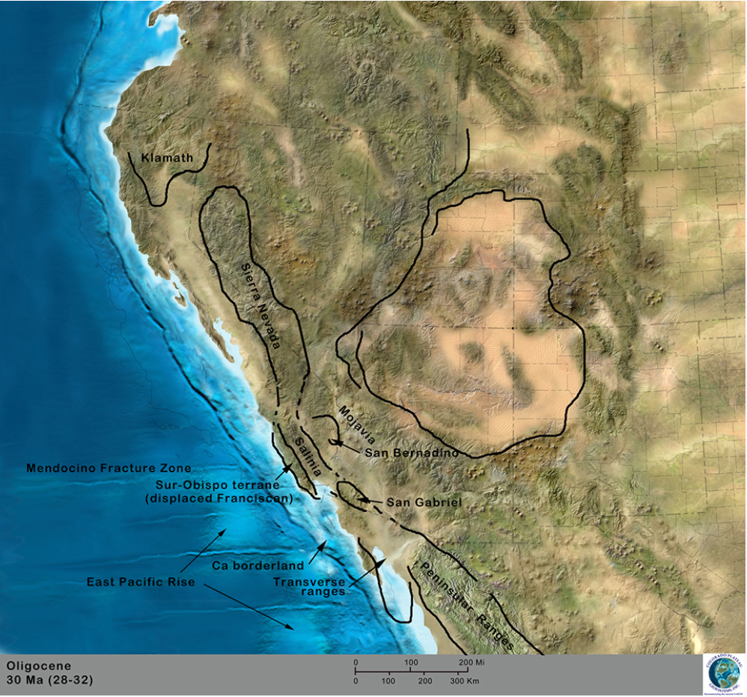

Slide 5
So it Begins…
MEB began to open 22Ma with major phase of extension from ~22-20Ma.
Dominated by regionally developed detachment faulting (low angle, brittle ductile faulting and rotational upper plate high angle normal faulting)
Then 20-17Ma high angle normal faults and dikes followed by later strike slip movement with the development of the San Andreas to the W

Slide 6
Using paleomagnetics early extension was orientated N-S and was rotated as much as 50° clockwise
20-18Ma
Western and Central Mojave rotated 25-50 ° clockwise
13-0Ma
Western and southern Mojave rotated 0-15 ° counterclockwise
13-0Ma
Central Mojave rotated 26 ° clockwise

Slide 10
Mojave Desert Block
Dominant structural elements include 7 high angle NW striking right lateral strike slip faults
Helendale, Lenwood, Camp Rock, Calico, Rodman-Pisgah, Ludlow, and Bristol Mountian
Bounded to the North by the Garlock Fault Zone
Bounded to the West by the San Andreas Fault Zone
Bounded to the East by the Granite Mountains Fault
Bounded to the South by the Pinto Mountain Fault

Slide 11
Setting the record straight
Other papers used paleomagnetic reconstructions where this paper uses dating of offset geologic features
Dokka found that these faults have accommodated 26.7-38.4km of cumulative right slip since 20Ma (not 105km)
Displacements on late Cenozoic strike-slip faults of the central Mojave Desert, California
Roy Dokka 1983

Slide 12
Mojave Extensional Belt
Strain here is partitioned into 4 domains
Edwards ( tilted 30-50° to SW)
Waterman (Highly variable w/ meta core complex exposures, lower plate
Daggett (~40 ° SW)
Bullion (~30 ° NE)
(each consist of one or more half graben with varying degrees of tilting)
The Mojave Extensional Belt of Southern California
Roy Dokka 1989

Slide 13
Transfer Zone
Kane Springs Fault
Differential extension between domains was accommodated by strike slip faults “transfer zones”
These zones accommodate differential extension between adjacent extensional terranes
These faults have straight traces and trend parallel to the extensional axis
Eg. Kane Springs fault separates the Daggett and Bullion terranes

Slide 14
Potential Kinematic Model
Extension in MEB potentially related to collapse of an over thicken crustal “welt” created by stacking of thrust sheets
Eg. Emplacement of Santa Lucia-Orocopia allochthon (remember San Gabriel) during late Cretaceous

Slide 15
End

